Slide 1
Chapter 33
Modeling Forward Rates

Slide 2
HJM Model: Notation
P(t,T ): | price at time t of a discount bond with principal of $1 maturing at T
Ω_{t} : | vector of past and present values of interest rates and bond prices at time t that are relevant for determining bond price volatilities at that time
v(t,T,Ω_{t} ): | volatility of P(t,T)

Slide 3
Notation continued
ƒ(t,T₁,T₂): | forward rate as seen at t for the period between T₁ and T₂
F(t,T): | instantaneous forward rate as seen at t for a contract maturing at T
r(t): | short-term risk-free interest rate at t
dz(t): | Wiener process driving term structure movements

Slide 4
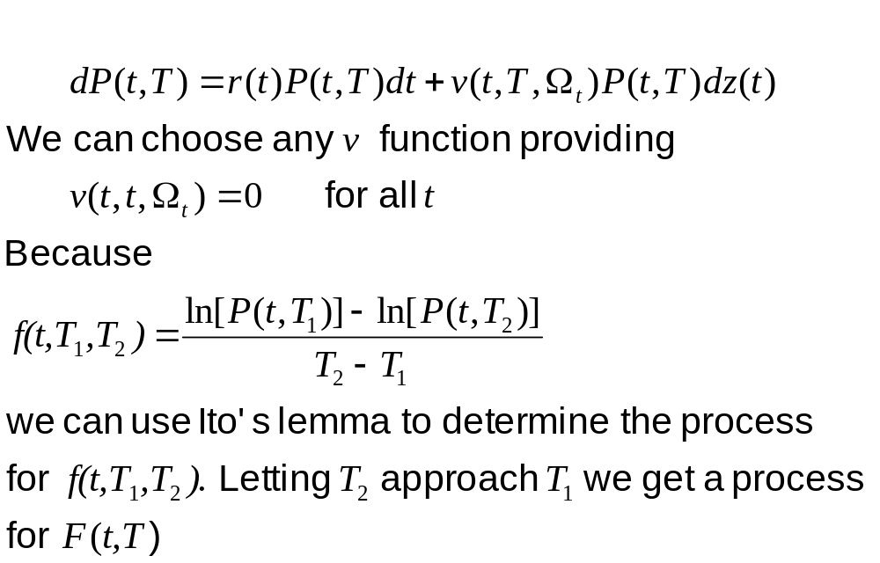
Modeling Bond Prices (Equation 33.1)

Slide 5
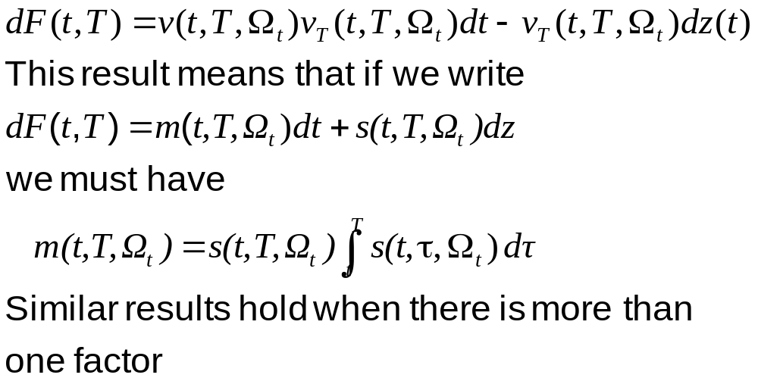
The process for F(t,T)
Equation 33.4 and 33.5)

Slide 6
Tree Evolution of Term Structure is Non-Recombining
Tree for the short rate r is non-Markov

Slide 7
The BGM Model
The BGM model is a model constructed in terms of the forward rates applicable to periods such as 3 months or 6 months (not instantaneous forward rates)
The forward rate volatilities for the periods considered can be determined from cap prices

Slide 8
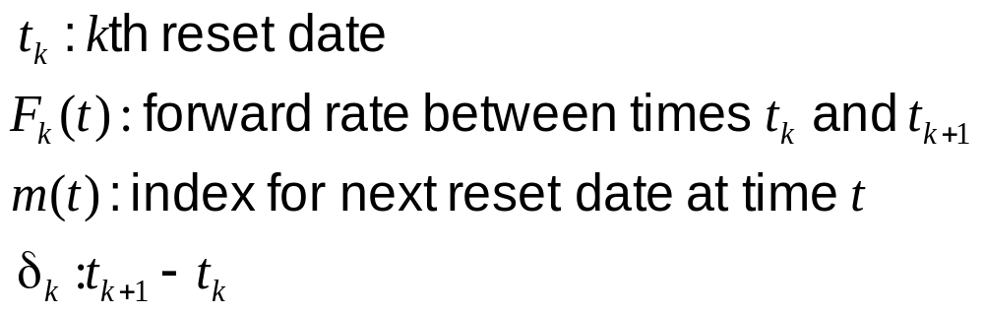
Notation

Slide 9
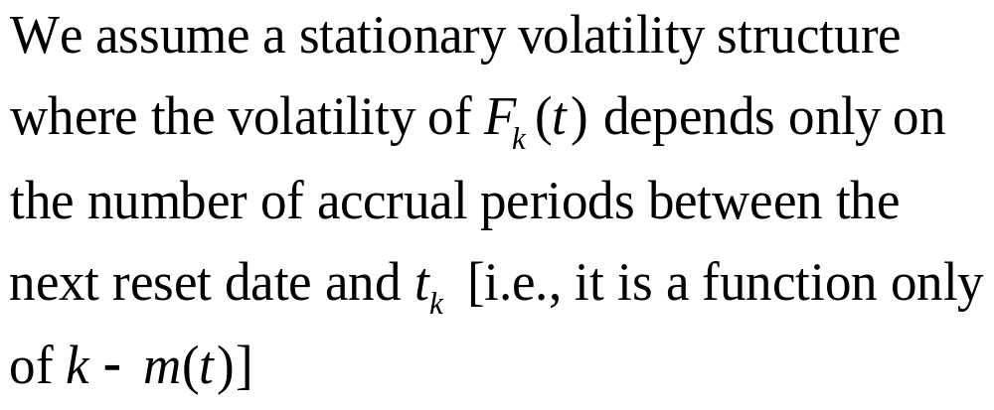
Volatility Structure

Slide 10
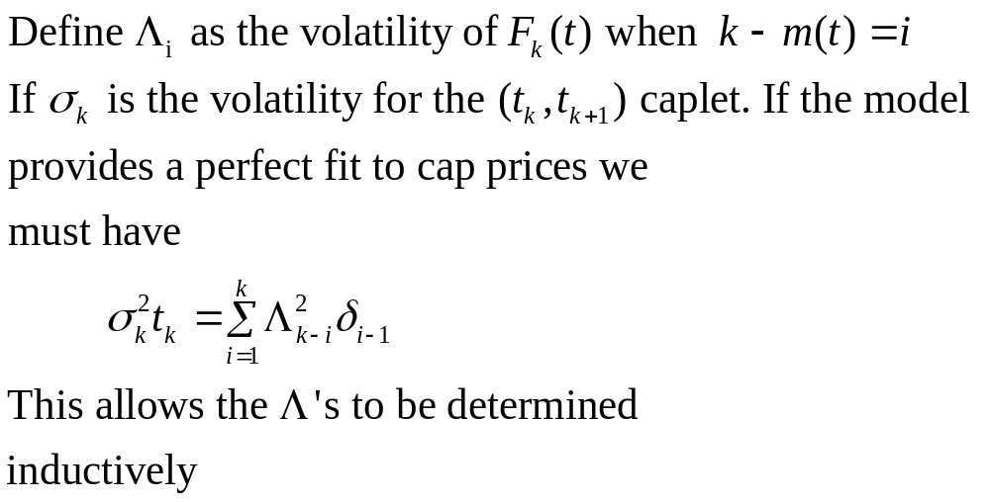
In Theory the Λ’s can be Determined from Cap Prices

Slide 11
Example 33.1
If Black volatilities for the first three
caplets are 24%, 22%, and 20%, then
Λ₀=24.00%
Λ₁=19.80%
Λ₂=15.23%

Slide 12
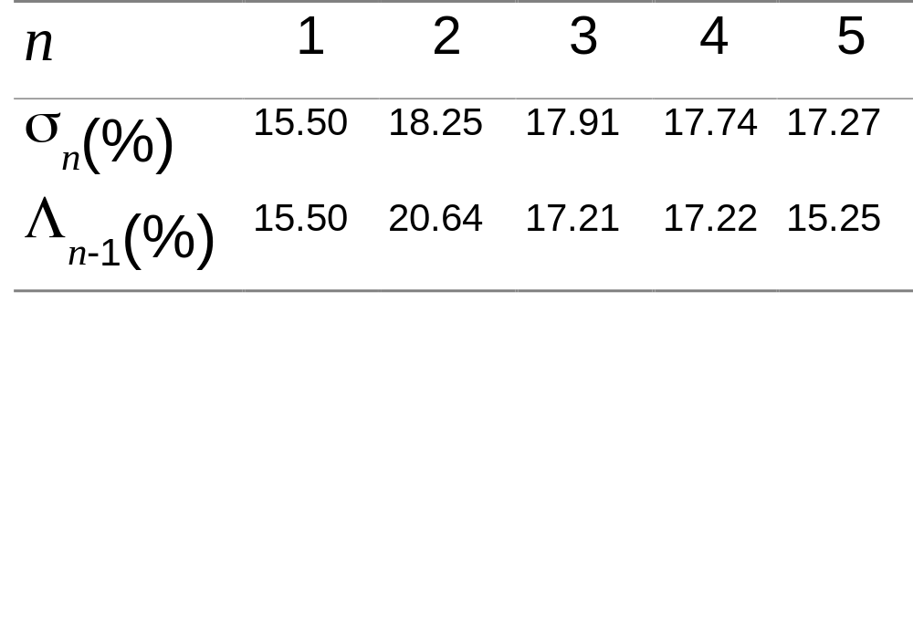
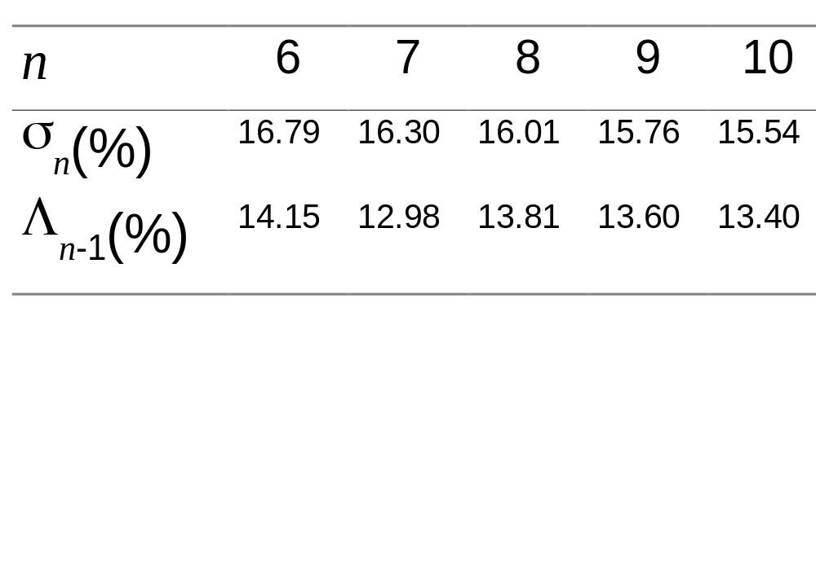
Example 33.2

Slide 13
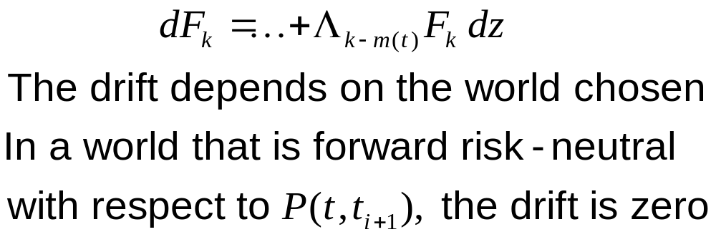
The Process for F_{k} in a One-Factor BGM Market Model

Slide 14
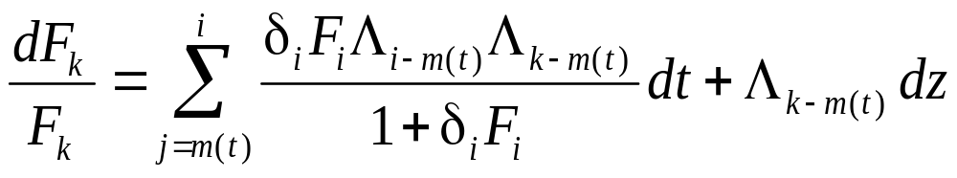
Rolling Risk-Neutrality (Equation 33.12)
It is often convenient to choose a world defined by a numeraire that is always the bond maturing at the next reset date. In this case, we can discount from t_{i+1} to t_{i} at the δ_{i} rate observed at time t_{i}. The process for F_{k} is

Slide 15
The BGM and HJM models
In the limit as the time between resets tends to zero, the BGM model with rolling risk neutrality becomes the HJM model in the traditional risk-neutral world

Slide 16
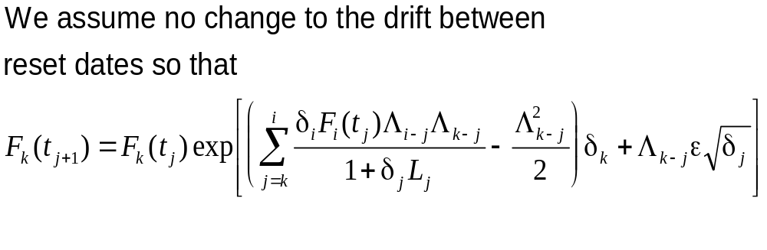
Monte Carlo Implementation of BGM Model (Equation 33.14)

Slide 17
Multifactor Versions of BGM
BGM can be extended so that there are several components to the volatility
A factor analysis can be used to determine how the volatility of F_{k} is split into components

Slide 18
Ratchet Caps, Sticky Caps, and Flexi Caps
A plain vanilla cap depends only on one forward rate. Its price is not dependent on the number of factors.
Ratchet caps, sticky caps, and flexi caps depend on the joint distribution of two or more forward rates. Their prices tend to increase with the number of factors

Slide 19
Valuing European Options in the BGM Model
There is an analytic approximation that can be used to value European swap options in the BGM model.

Slide 20
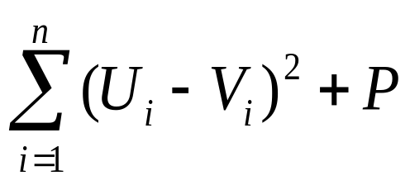
Calibrating the BGM Model
In theory BGM can be exactly calibrated to cap prices as described earlier
In practice we proceed as for short rate models to minimize a function of the form
where U_{i} is the market price of the ith calibrating instrument, V_{i} is the model price of the ith calibrating instrument and P is a function that penalizes big changes or curvature in a and σ

Slide 21
Types of Agency Mortgage-Backed Securities (MBSs)
Pass-Through
Collateralized Mortgage Obligation (CMO)
Interest Only (IO)
Principal Only (PO)

Slide 22
Option-Adjusted Spread
(OAS)
To calculate the OAS for an interest rate derivative we value it assuming that the initial yield curve is the Treasury curve + a spread
We use an iterative procedure to calculate the spread that makes the derivative’s model price = market price.
This spread is the OAS.

